Slide 1


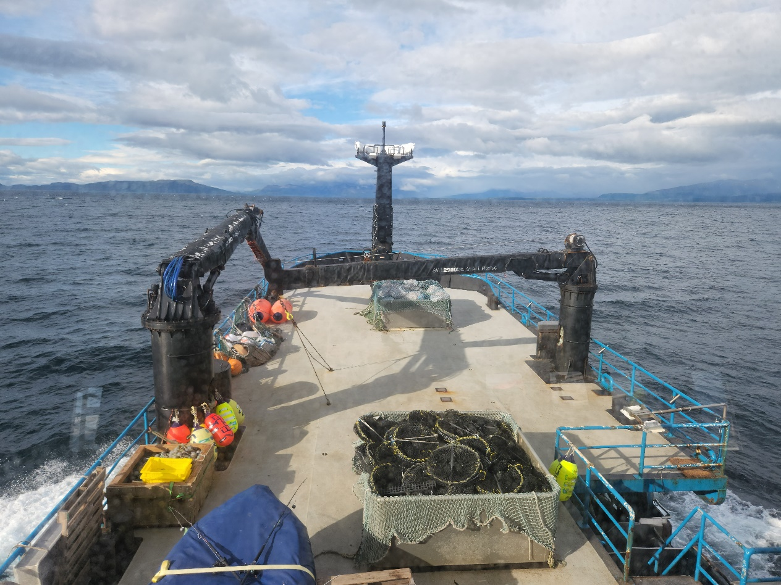
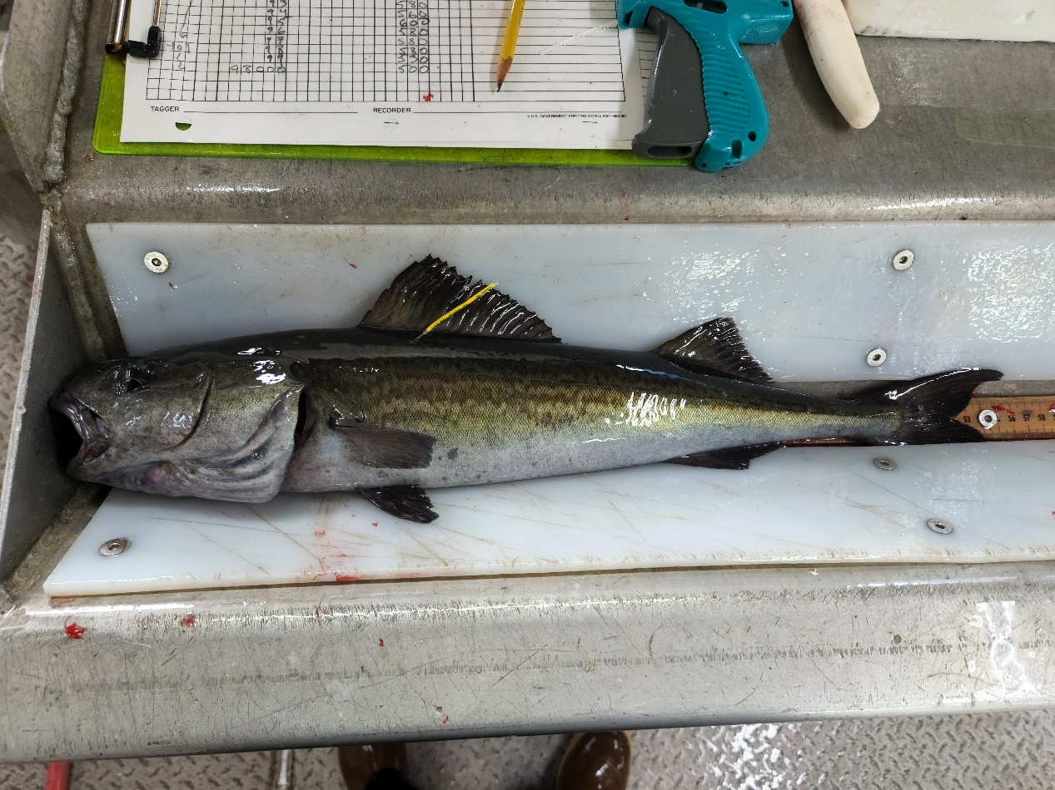

Sablefish Background, Biology, and Key Uncertainties
2026 CIE Review
Daniel Goethel and Matt Cheng
Contributors: Kevin Siwicke and Katy Echave
June 2026

Slide 2
Agenda

Slide 3
Terms of Reference (ToRs)
Days 1-2
Day 3

Slide 4
Documents and Materials
Documents For Review (available here)
2026 Assessment of the Sablefish Stock in Alaska: 2026 Center for Independent Experts (CIE) Review Document (here)
Appendix 3A. The Spatial Population over Regional Components (SPoRC) Model: Technical Description of the Assessment Model for Sablefish (here)
Appendix 3B. Model Building and Bridging Exercise for the Sablefish Single Region Models (Bridging from Model 25.12 to 26.1_1Reg) (here)
Appendix 3C. Development of a Fleets-as-Areas (FAA) Stock Assessment Model for Alaska Sablefish (Model 26.2_FAA) (here)
Appendix 3D. Results of Spatial Stock Assessment Models for Alaska Sablefish (here)
Appendix 3E. Evaluating Alternative Assessment Structures for Alaska Sablefish Under Survey Design Changes via Closed-Loop Simulation (here)
CIE GitHub Repo:
https://github.com/dgoethel-noaa/2026_Sablefish_CIE/tree/main
Contains model runs and model outputs
CIE Doc Repo:
https://drive.google.com/drive/folders/1LB7eJd90IGOIImOwkEZntPfykbwmA7I7?usp=sharing
Contains files for review and background files
Days 1-2
Day 2
Day 3
Day 2

Slide 5
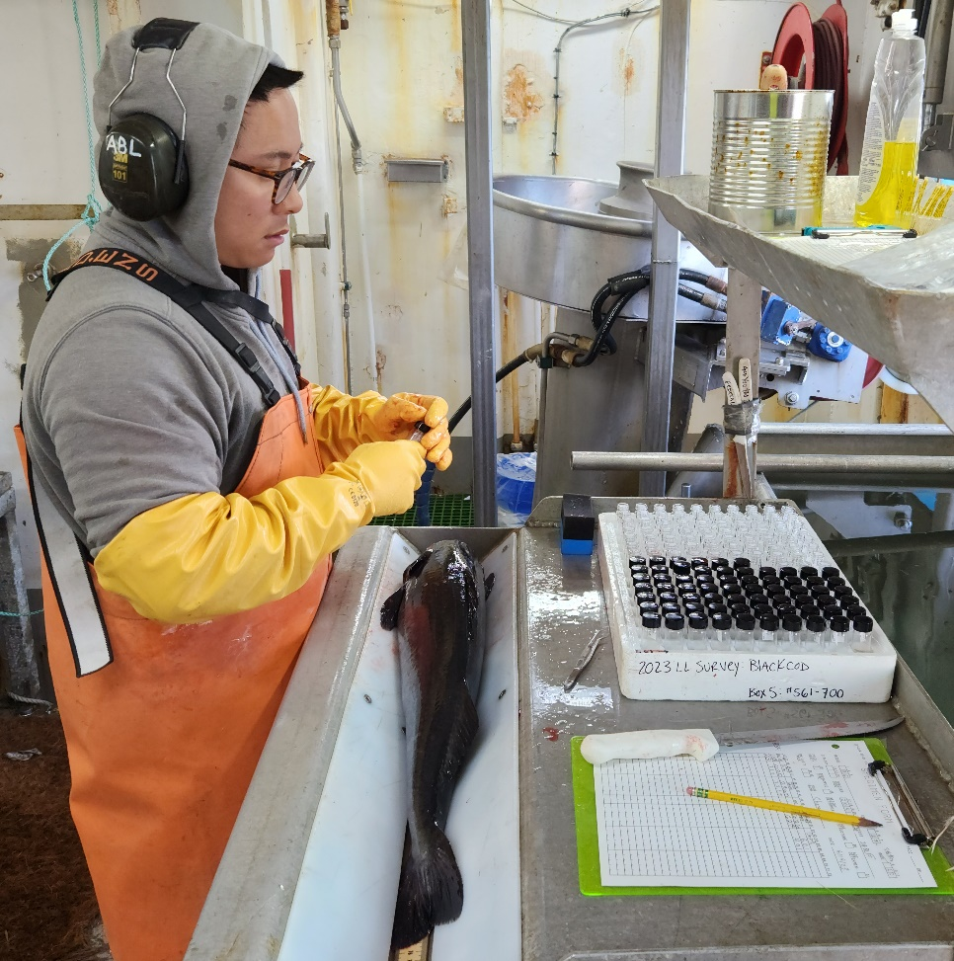
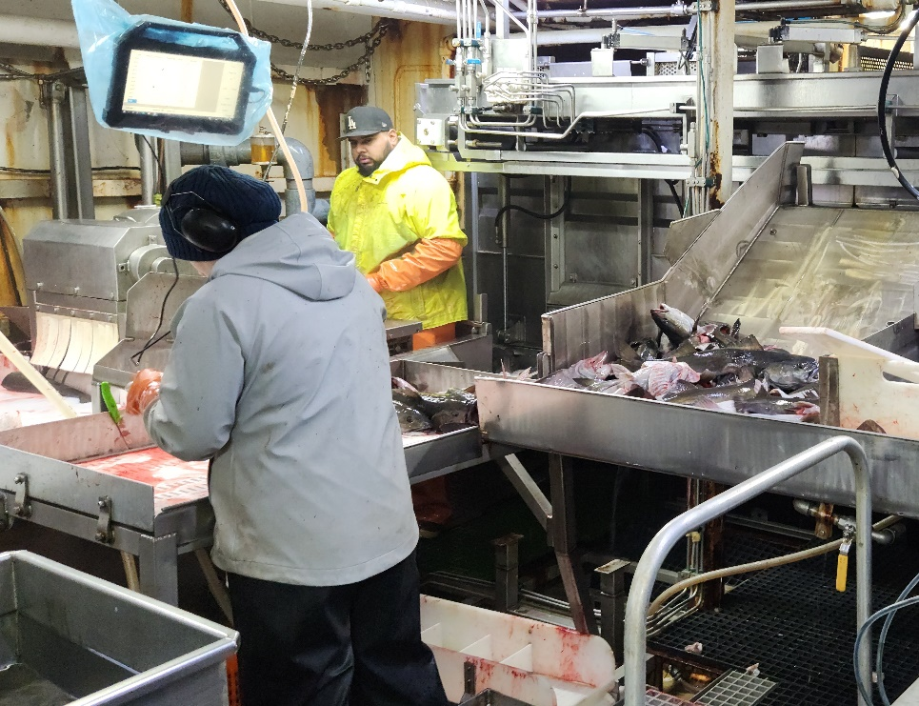
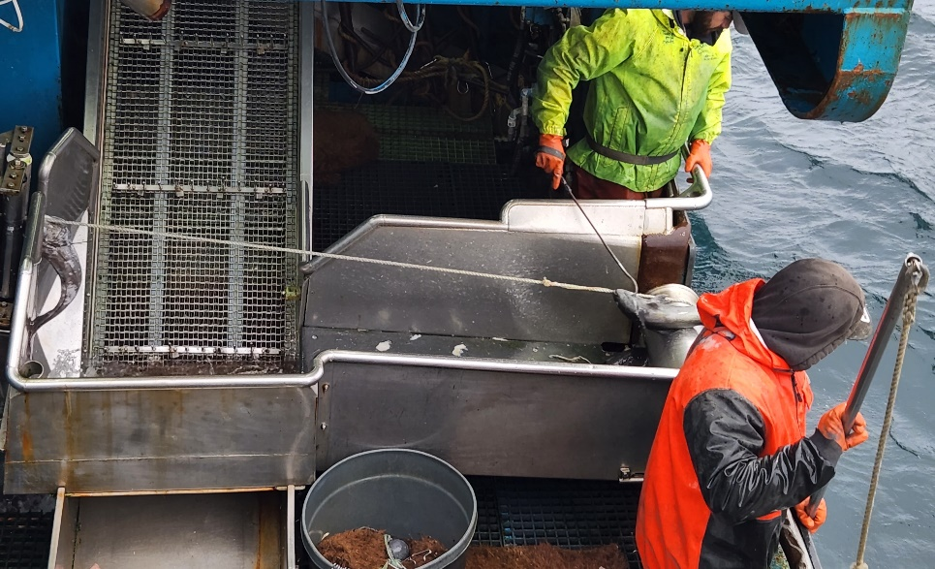
Primary Sablefish Concerns (foreshadowing)
How best to handle recent changes in NOAA Longline Survey (LLS) design?
Should a fleets-as-areas (FAA) model be used to avoid extrapolating LLS indices? (ToR 1+2)
How can the spatial model be improved for potential future use as the basis of management advice? (ToR 3)

Slide 6
Secondary Sablefish Concerns
Are best practices for modeling sex- and fleet-structure being used in the assessment?
Which data should be included in the assessment (e.g., indices, length compositions)?

Slide 7


Units
Throughout the documents/presentations:
Mass (i.e., for spawning stock biomass, SSB, biomass, and catch) is reported in metric tons
Abbreviated as either mt or t (equivalent to a tonne) or kilotons (kt; equivalent to 1,000 metric tons).
mt is standard notation in US to avoid confusion with short ton or long ton.
Recruitment (age-2) and abundance are in millions of fish
Fishing and natural mortality are instantaneous rates (year⁻¹).

Slide 8
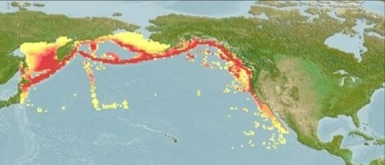
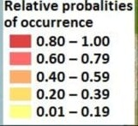
Population Structure and Spatial Distribution
Mateo et al. (2018)
Distributed across northwestern Pacific from Mexico through Japan
Highest concentrations in Alaska
No significant genetic structure across their range
High mobility and dispersal
Assessed and managed as separate stocks on:
US West Coast (Pacific Council)
Canadian British Columbia (DFO)
Alaska Federal Waters (North Pacific Council)
Alaska State Waters (ADFG)
AK
DFO
US WC
Kapur et al. (2024)

Slide 9
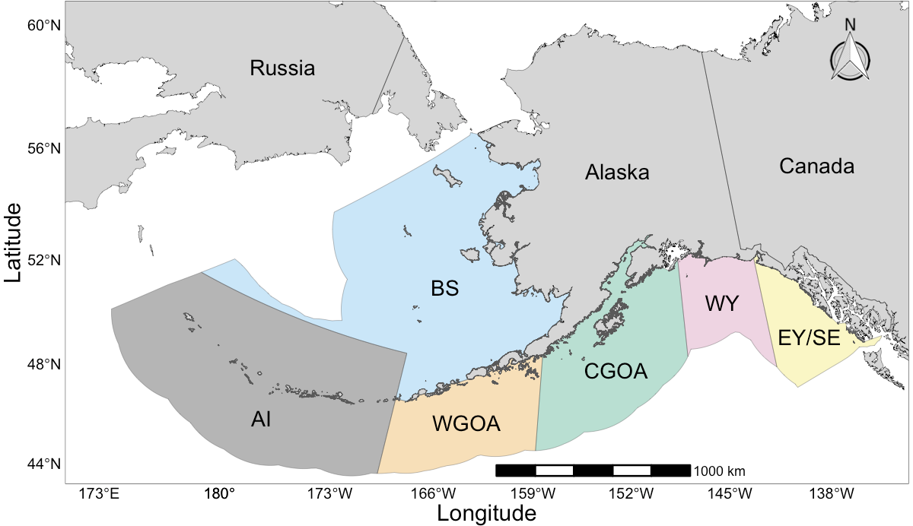
Management Structure
Only AK-wide managed stock for NPFMC
Spans 3 large marine ecosystems:
Bering Sea (BS)
Aleutian Islands (AI)
Gulf of Alaska (GOA)
Alaska-wide Acceptable Biological Catch (ABC) is apportioned to the 6 management regions:
BS, AI, WG, CG, EG (WY/SEO)
Based on moving 5 year average of LLS biomass proportions across regions
Attempts to distribute fishing pressure proportional to biomass

Slide 10
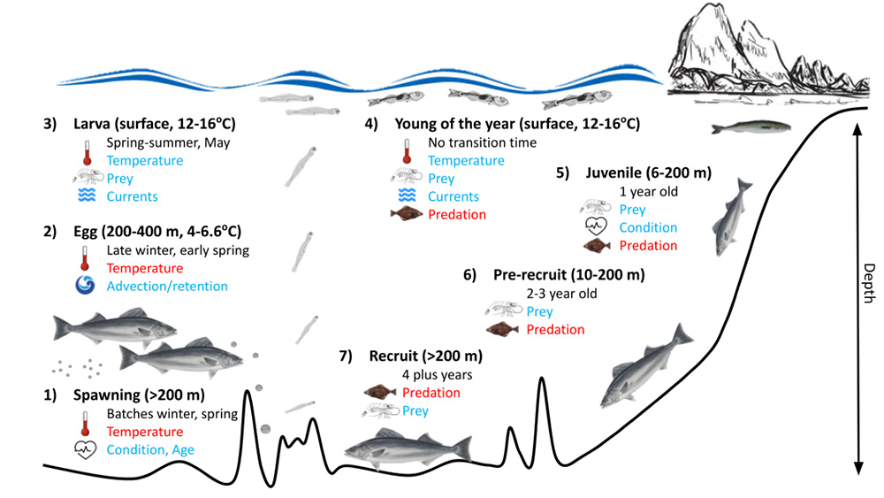
Life History
Long-lived (> 90 years)
Deep-dwelling (100 – 1500 m)
Sexually dimorphic growth
Fast growing as juveniles
Late maturation
a_{50%} ~ age-7
Fully mature ~ age-12
Spasmodic recruitment
Juveniles migrate from shallow inshore to deep offshore habitat
Shotwell et al. (2023)

Slide 11
Early Life History
Adults are found predominately on the continental slope > 200m
Spawning occurs offshore in late winter and early spring (Jan – Mar)
Location of spawning is unknown but may be associated with seamounts
Batch spawners
Potential for skipped spawning especially at younger ages
Pelagic eggs and larvae are transported to nearshore waters
Juveniles settle on continental shelf in nearshore bays (SE AK) and eastern BS

Slide 12
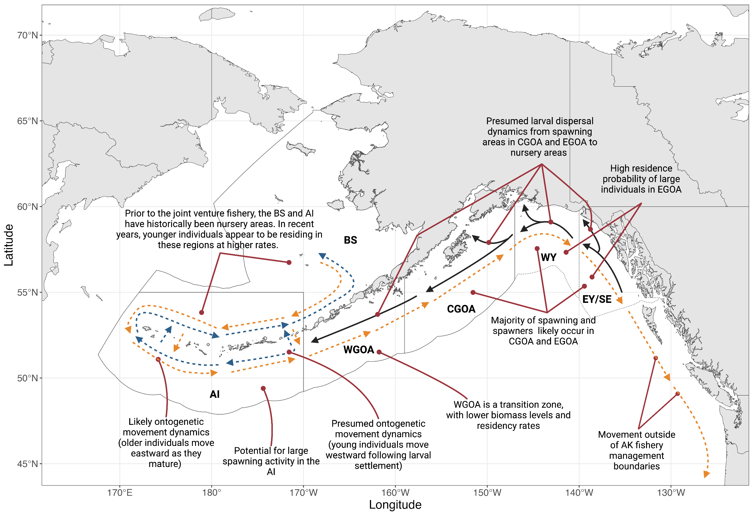
Movement and Migration
One of the longest running mark-recapture programs in the US
Generally demonstrate a counter-clockwise ontogenetic movement pattern in Alaska
BS likely represents a historic nursery area for large cohorts
Migrate to adult habitat (offshore slope) between ages 2 and 5
Mature sablefish tend to be found in the CG/EG and western AI
Extensive transboundary movement
Juvenile Fish Move Westward (BS Nursery Area?)
Mature Fish Move Eastward

Slide 13
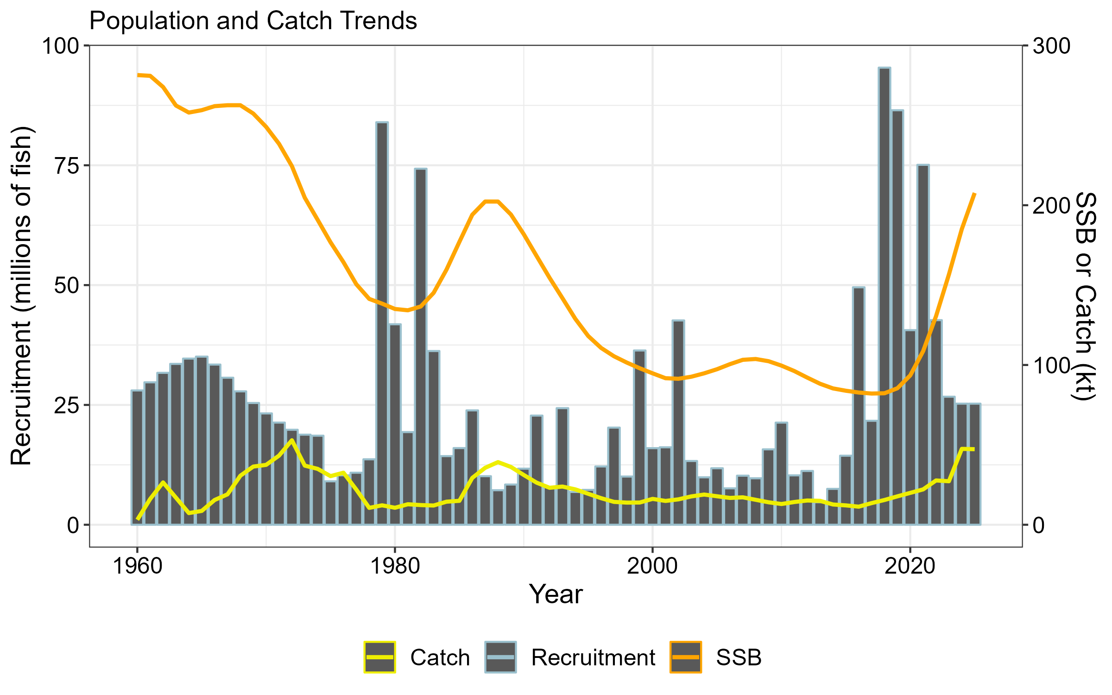
Recruitment and Long-term Trends
Spasmodic recruitment occurs in pulses, rapidly increasing biomass and quotas
Late 1970s, early 2000s, and since 2015
Maturing fish must sustain SSB and fishery for 15+ years
Stock was on a long-term downward trend until recently
Recent increases coincide with onset of marine heatwaves, indicating sablefish might be a ‘climate winner’

Slide 14
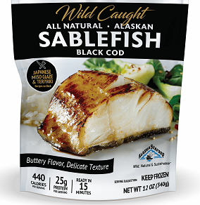

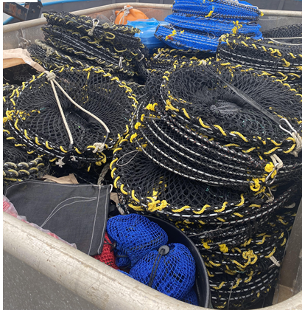
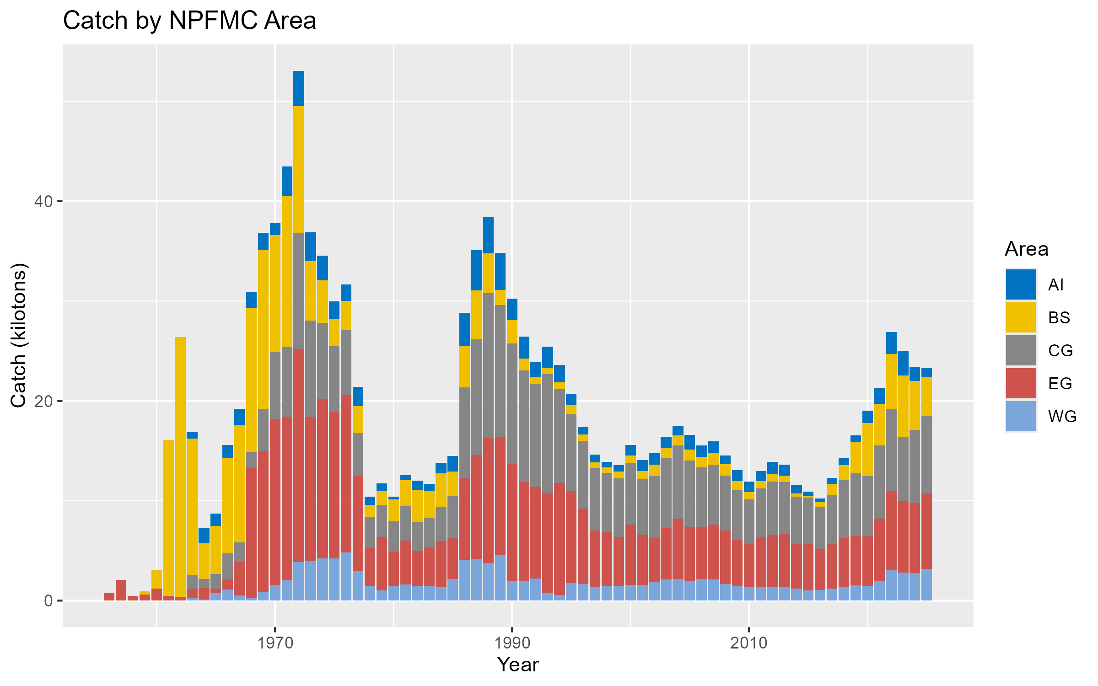
Fishery Background
Japanese fishery started in the 1960s in BS and expanded into the GOA in 1970s
Fully domestic fleet by 1982
Traditionally hook and line gear, but recent and rapid transition to longline slinky pots
IFQs since 1995
Full retention fishery
Primarily in GOA, with moderate BS/AI catch
Moderate trawl catch from two fleets – pelagic trawl (BS) and bottom trawl (AI + GOA)

Slide 15
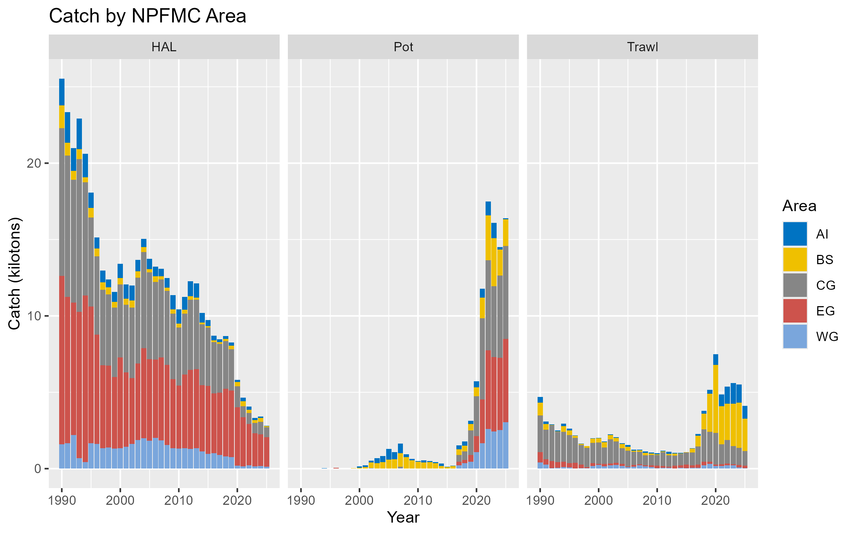
Fishery Background
Japanese fishery started in the 1960s in BS and expanded into the GOA in 1970s
Fully domestic fleet by 1982
Traditionally hook and line gear, but recent and rapid transition to longline slinky pots
IFQs since 1995
Full retention fishery
Primarily in GOA, with moderate BS/AI catch
Moderate trawl catch from two fleets – pelagic trawl (BS) and bottom trawl (AI + GOA)

Slide 16
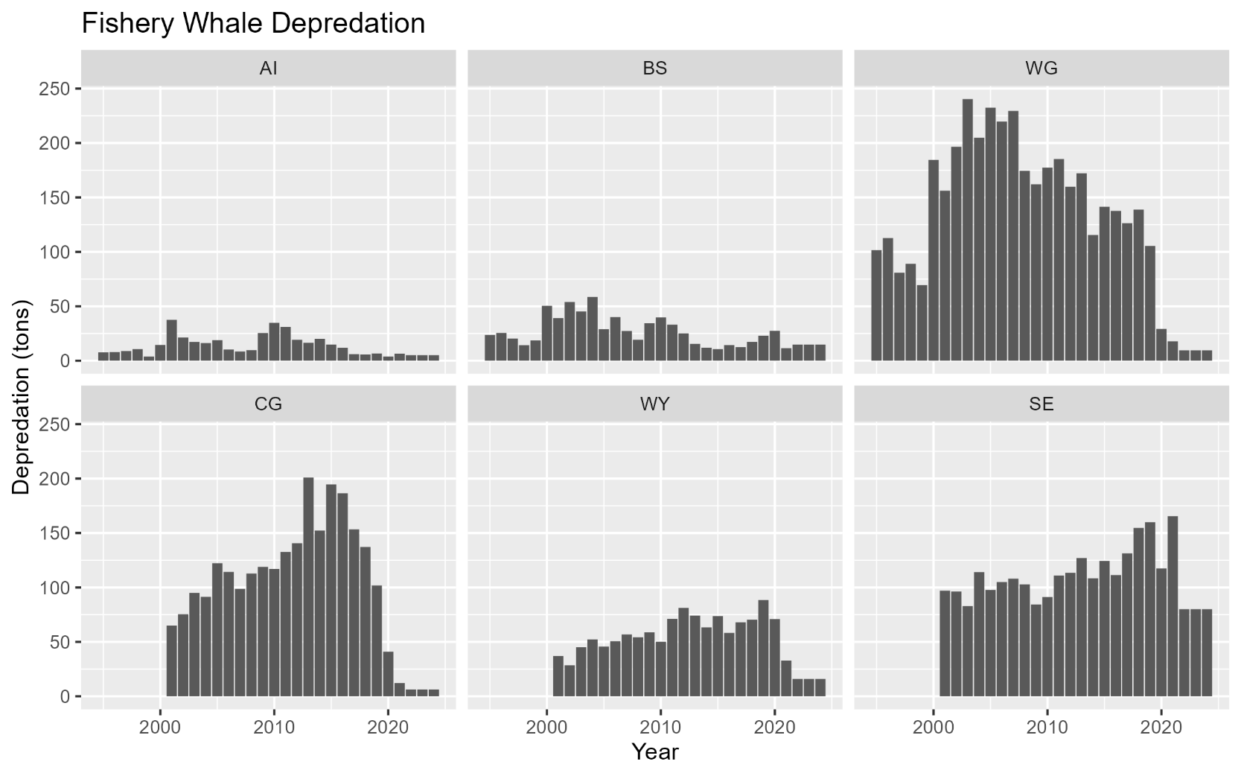
Whale Depredation
Fishery whale depredation on hook-and-line gear had been increasing rapidly throughout the 2000s
Primarily killer whales in the western regions (AI, BS, and WG) and sperm whales in the eastern regions (CG, EG)
Depredation lower in AI and BS due to use of pot gear
Since pot gear was legalized in the GOA depredation has decreased rapidly as the fishery has shifted to primarily to slinky pots

Slide 17
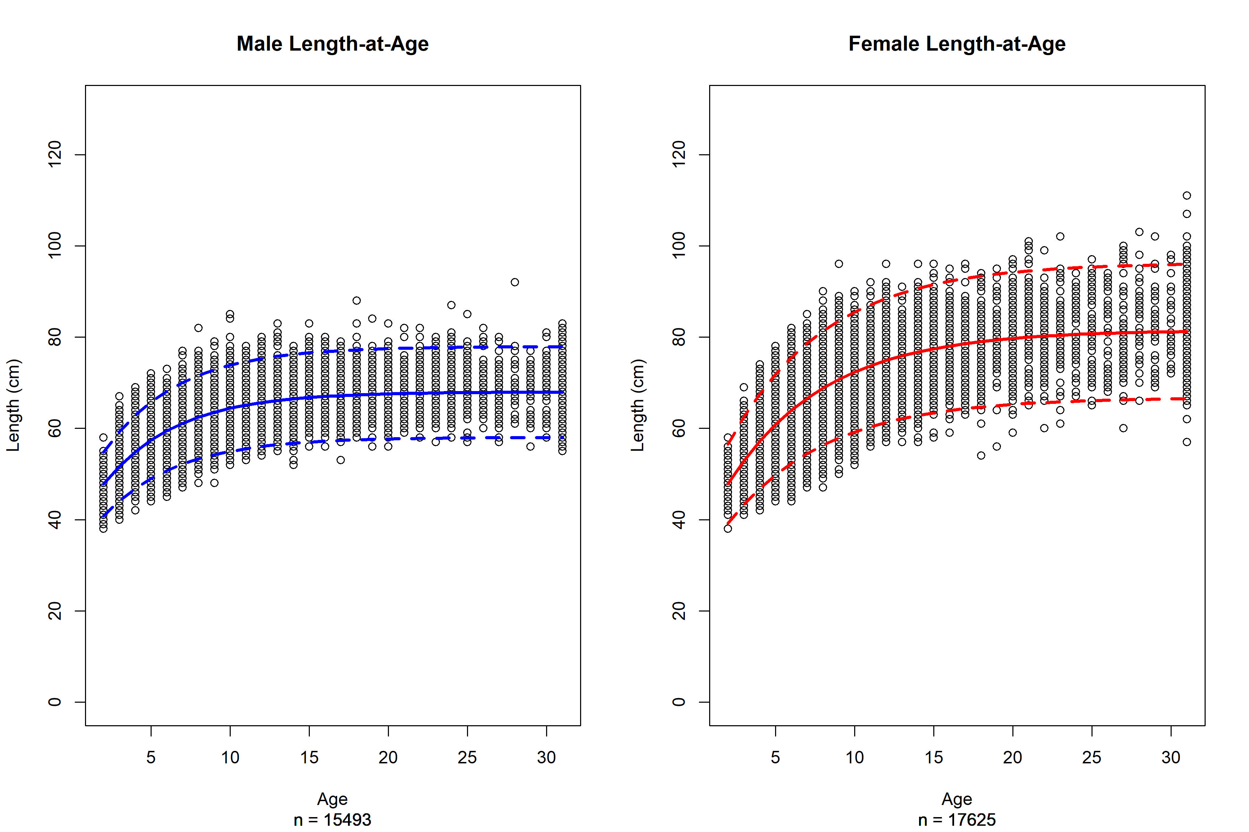
Growth
Estimate VBGF based on paired age-lengths from LLS since 1996 (beginning of random sampling)
A pre-1996 growth curve is used for fitting historic Japanese LLS lengths based on bias-corrected length-stratified data (see Echave 2021)
Strong sexual dimorphism,
Similar growth patterns until ~ age-5
Much larger asymptotic sizes for females (82 cm vs. 68 cm)
Assessment uses size-age transition matrix to convert predicted age compositions to length compositions

Slide 18
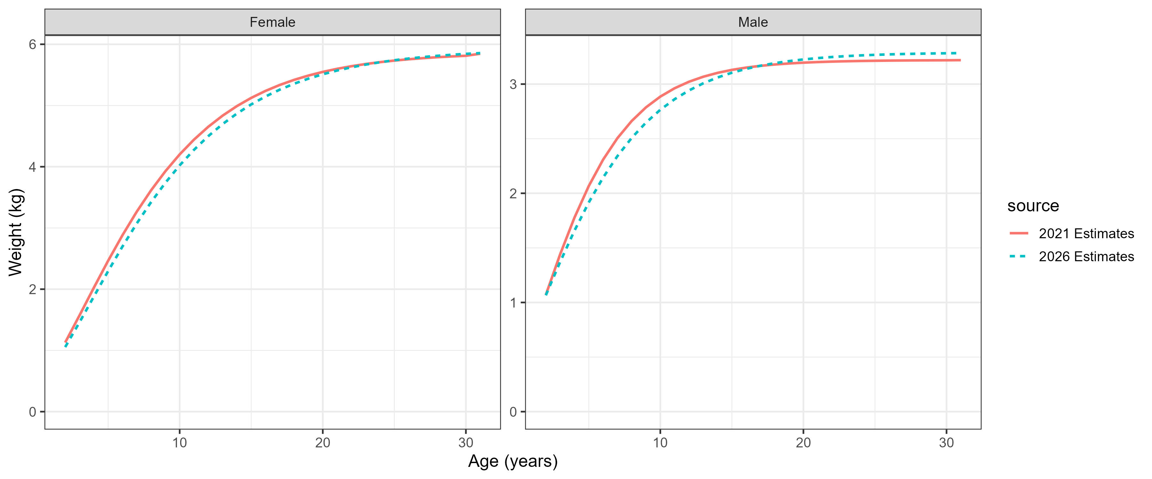
Weight
Estimated based on paired length-weight observations from LLS since 1996 (beginning of weight sampling)
A single weight-at-age curve is used in the assessment

Slide 19
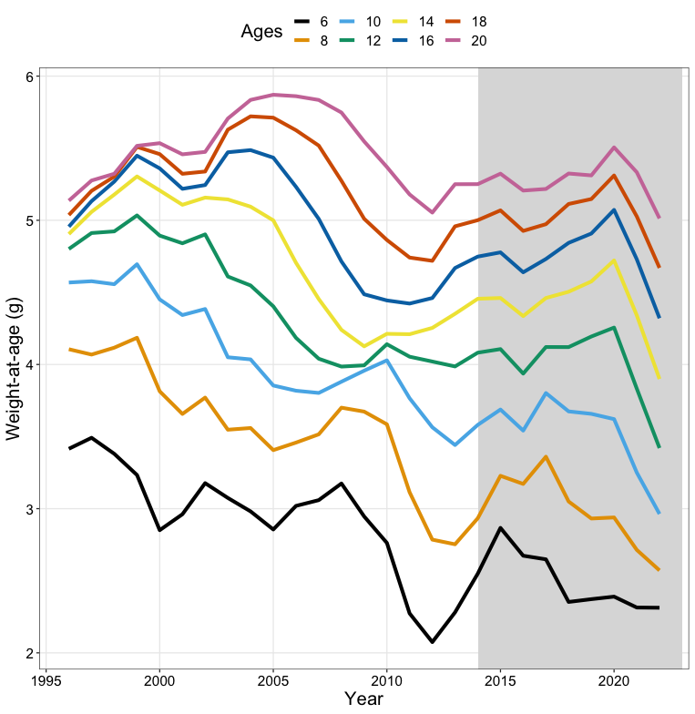
Density-Dependence(?)
Reduced length- and weight-at-age coincides with recent high recruitment events
Likely coupled with environmental drivers
Time-varying growth could complicate the use of length compositions in the assessment if not adequately modeled
Time-varying weight could have implications for BRPs, SSB, and catch advice

Slide 20
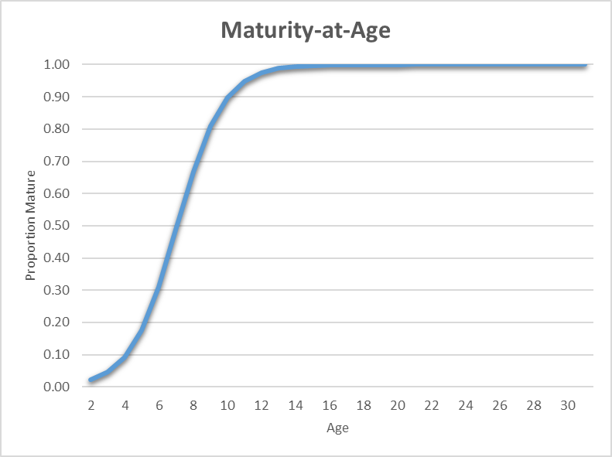
Maturity
One maturity time block based on histological samples
a_{50%} ~ age-7
Fully mature ~ age-12

Slide 21
Age at Recruitment and Sex Ratio
Sablefish appear on continental slope around age-2 at fork length of 45 cm
First appear in LLS and LLF around the same age/size, but in relatively low frequency
Higher interactions with pelagic trawl fishery in the EBS at smaller sizes
Assessment models age-2+, length 40 cm+
No indication of a strong divergence from 50:50 sex ratio based on LLS sampling

Slide 22
Ageing Error
Sablefish are difficult to age
Ageing error matrix developed based on 172 known-age otoliths from age-1 tagging studies
The ageing error matrix is directly incorporated into the assessment predictions of age compositions to account for uncertainty in the ageing process.

Slide 23
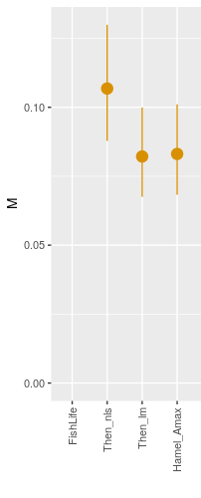
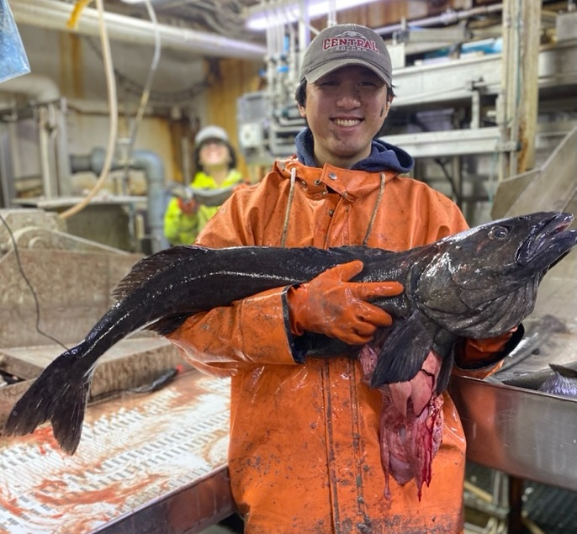
Natural Mortality
Natural mortality is difficult to estimate in the assessment
a_{max} ~ 94 years in AK (~102 for WC)
Only 6 fish > 70 years old in LLS age compositions
M estimated to be 0.085 from tagging data
An average longevity of 65 years equates to M ~ 0.085
WC and BC assessments estimate M ~ 0.09.
Current assessment M prior is ~N(ln(0.085), 0.1²)
Longevity = 65 yrs
Cope: http://barefootecologist.com.au/shiny_m

Slide 24
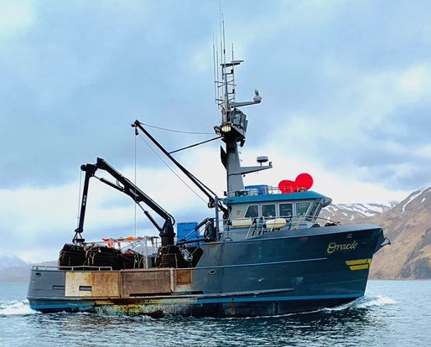
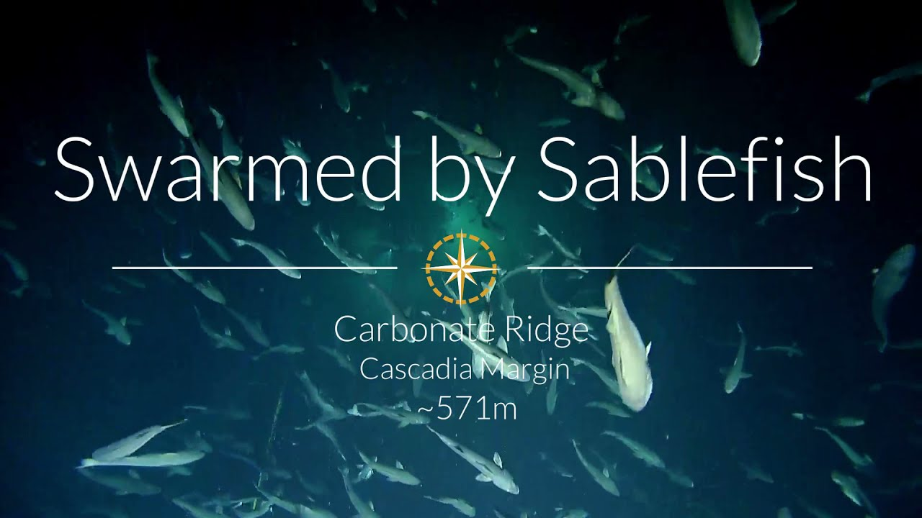
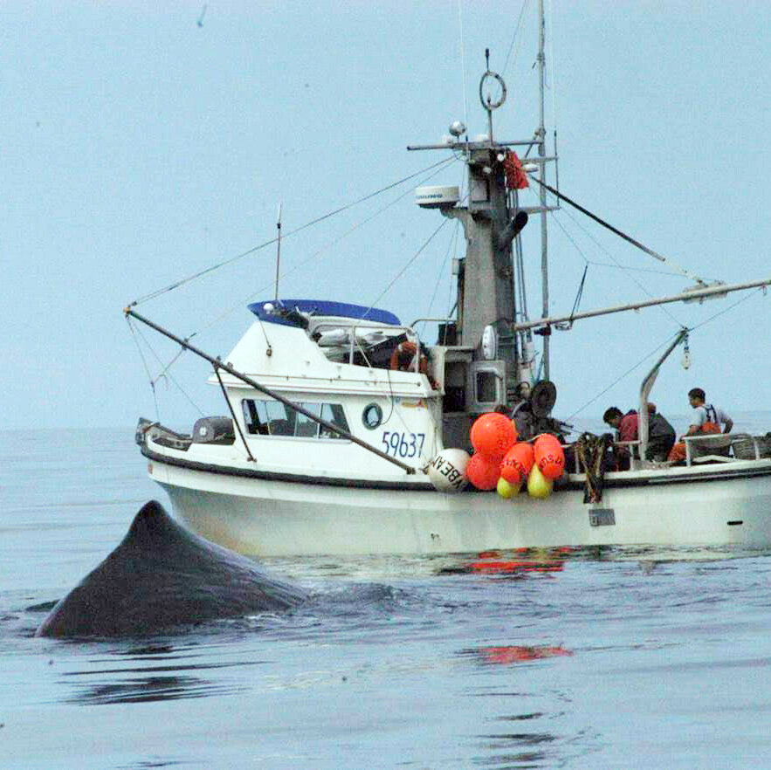
Key Considerations for Assessment
National Fisherman
Long-lived (low M), difficult to age (aging error matrix integrated), and relatively late maturation
Widely distributed (AK-wide assessment) but no population structure (single population)
High mobility with ontogenetic migrations (differential availability to fishery/surveys across regions)
Spasmodic and cyclic recruitment, likely influenced by environmental factors (lack of a well-defined SRR)
Sexually dimorphic (sex-specific growth/selectivity)
Multiple fisheries with different interactions with sablefish (multiple fleets with different selectivity)
Rapid changes in fixed gear fishery (time-varying selectivity)
Depredation has been high but decreased due to pot gear usage
ALFA

Slide 25
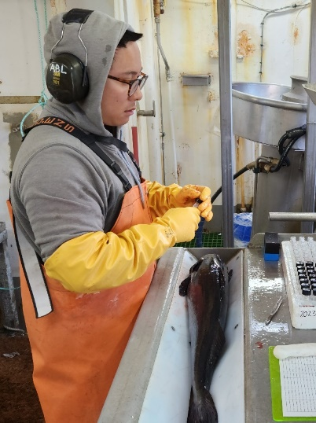

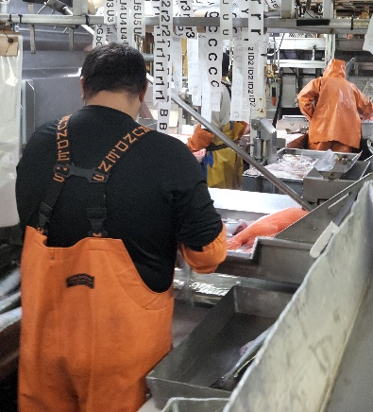
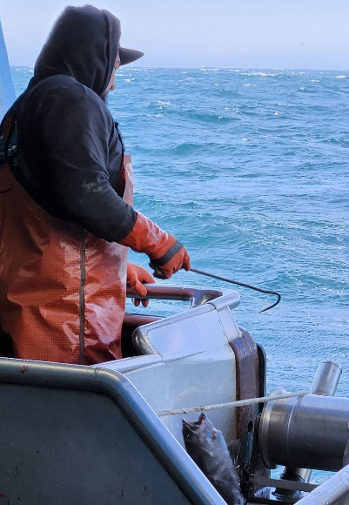
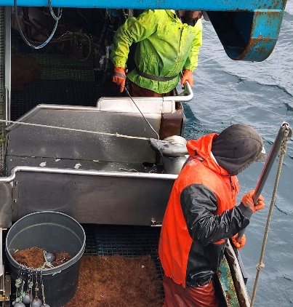
QUESTIONS?

Slide 26
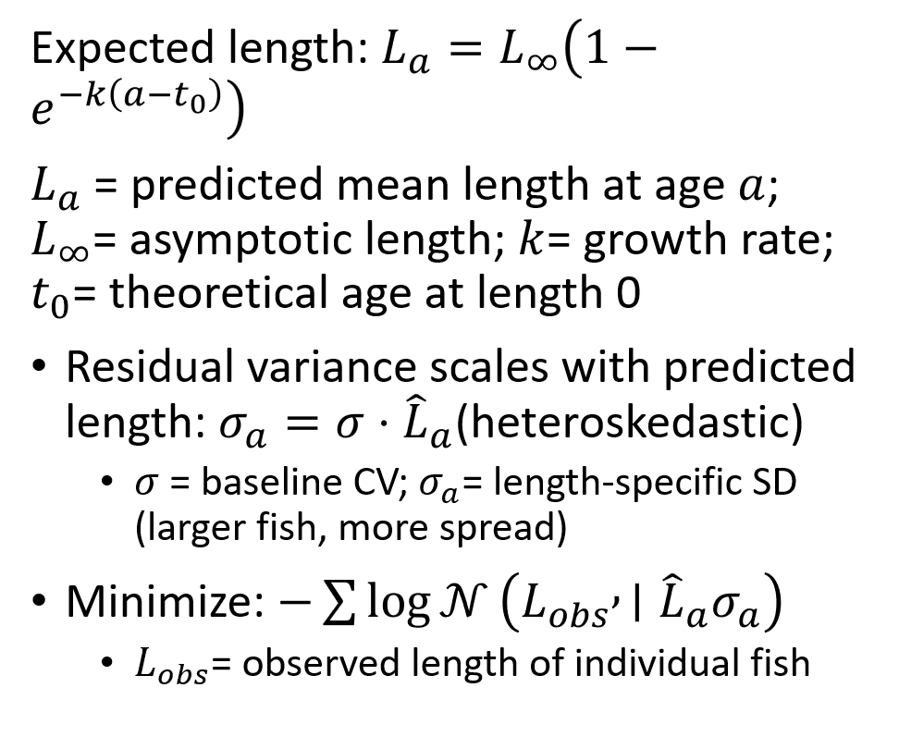
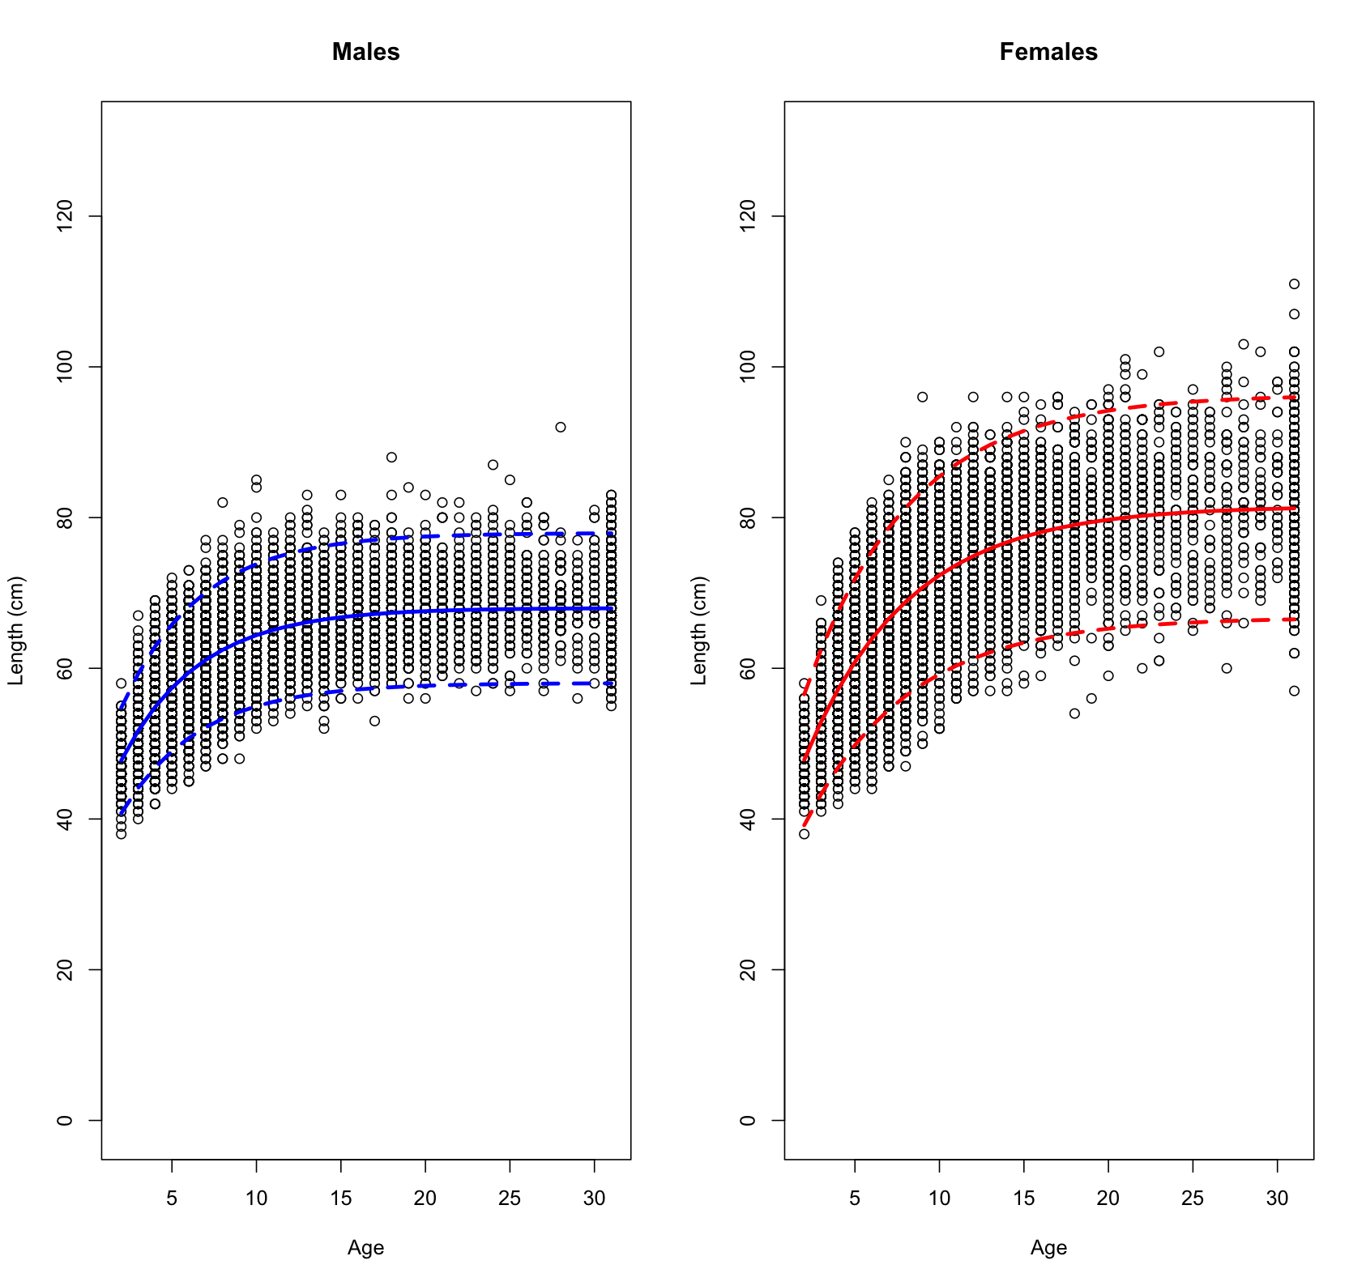
Growth Estimation

Slide 27
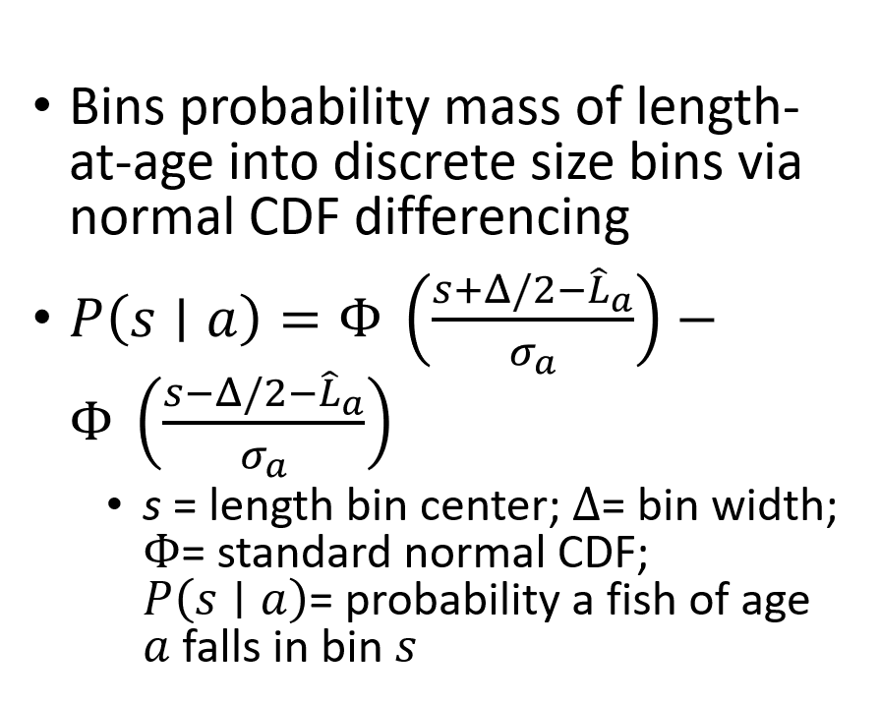
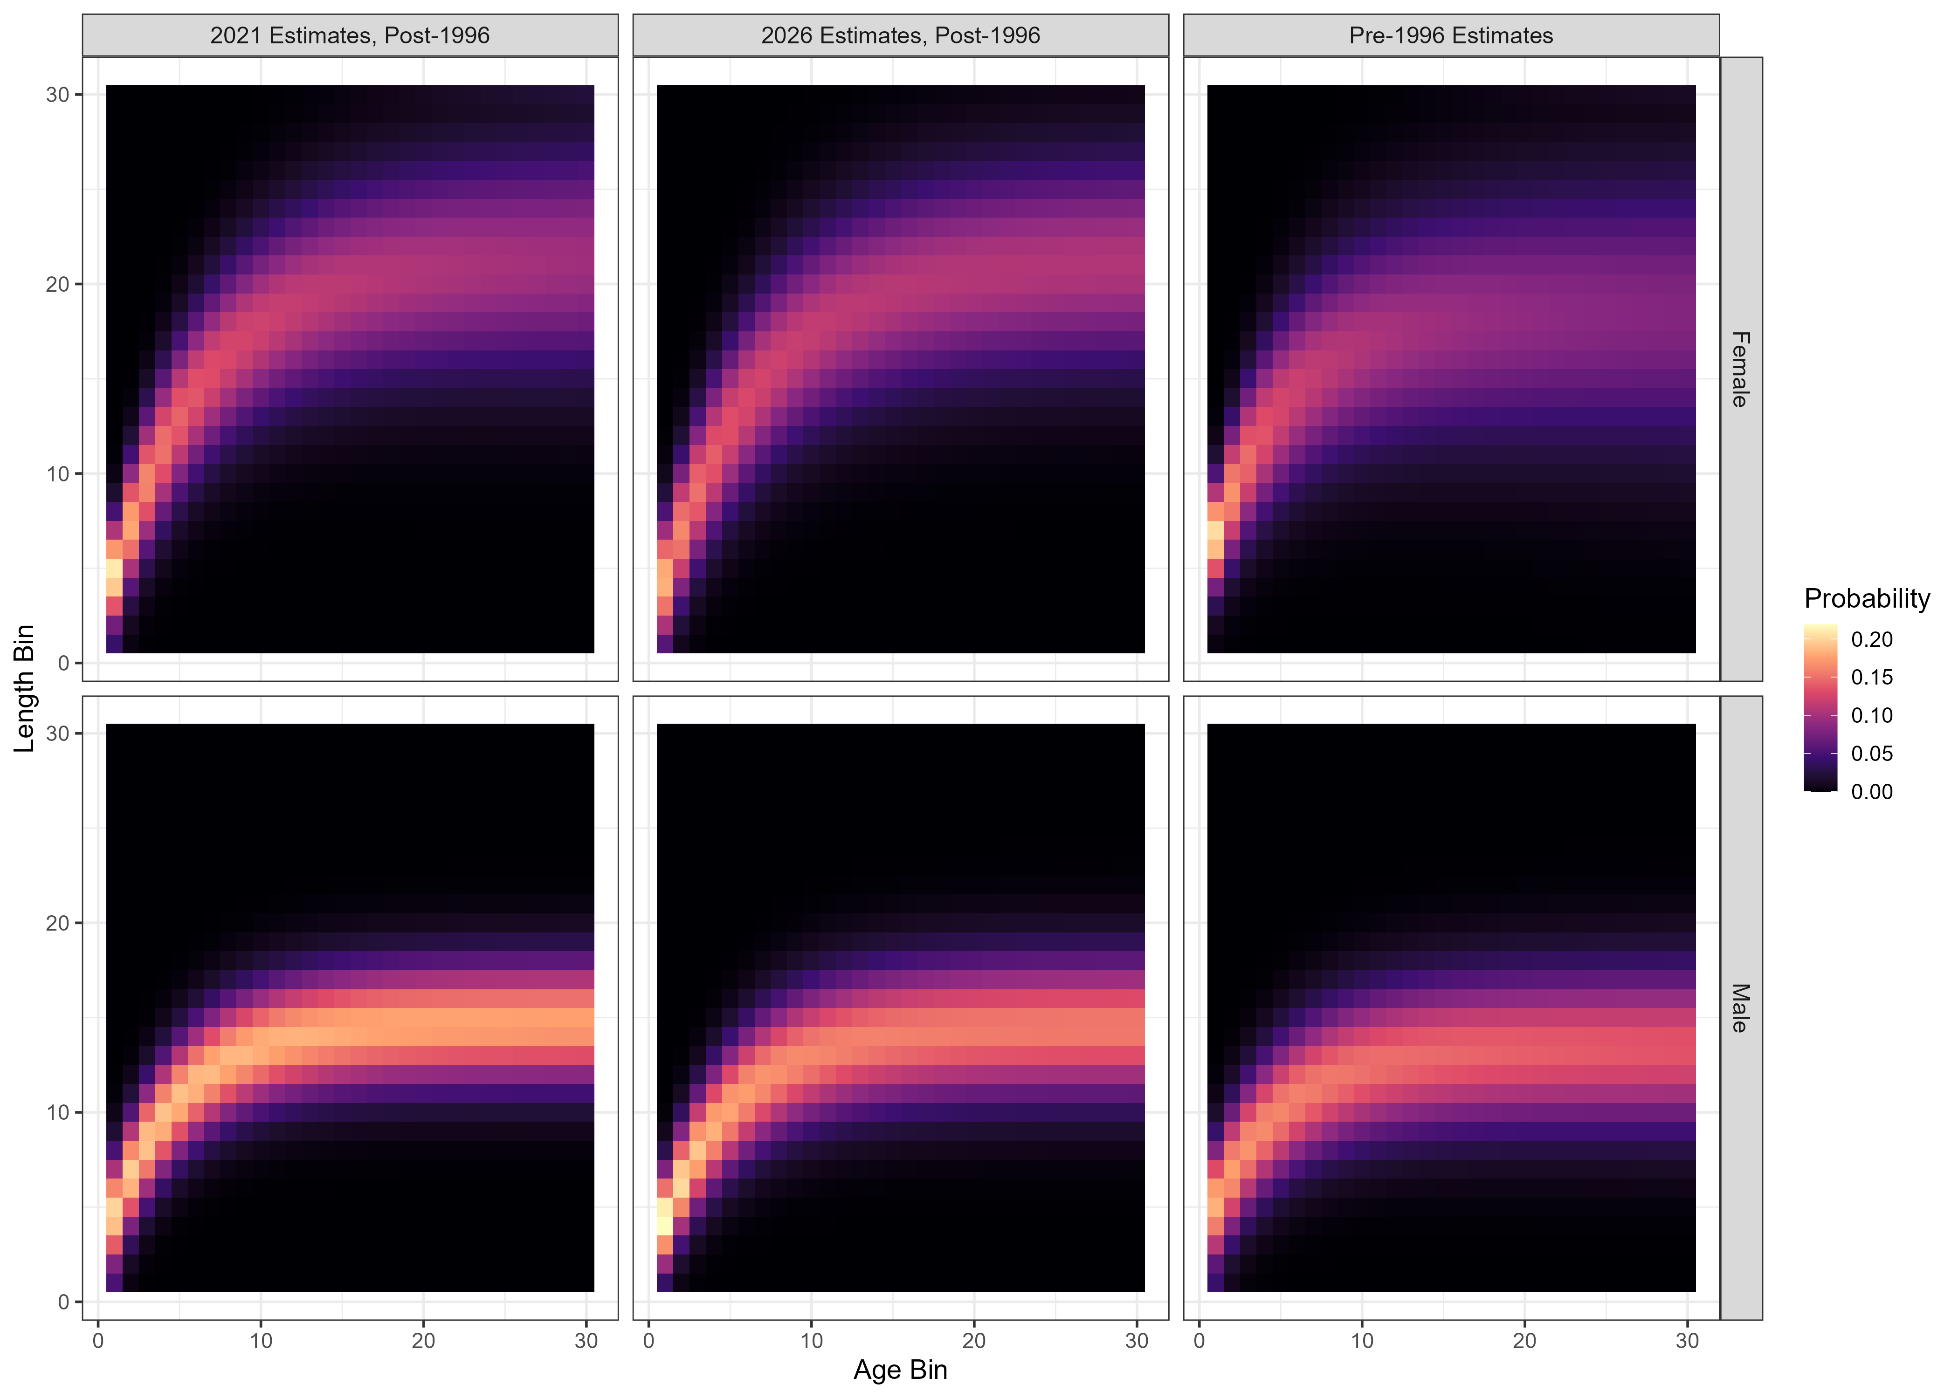
Size-Age Transition Matrix

Slide 28
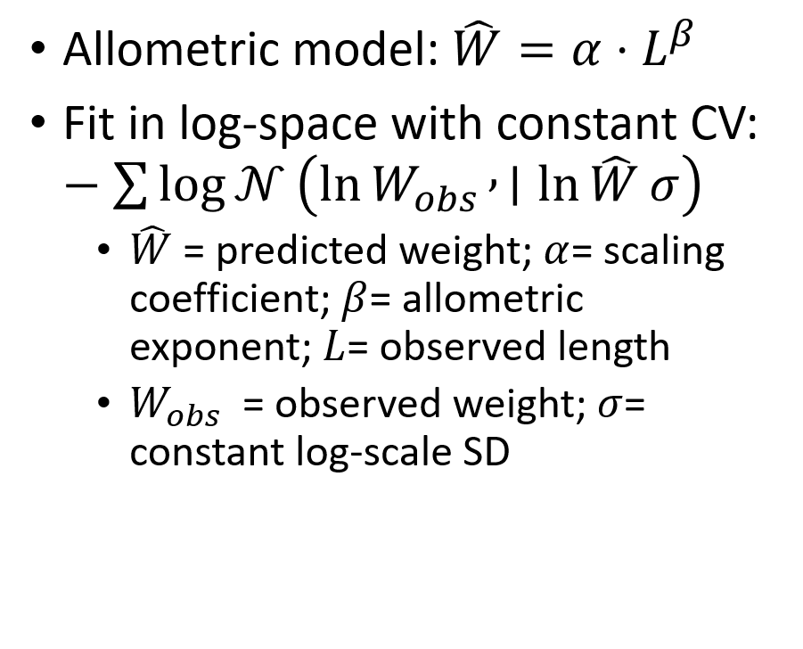
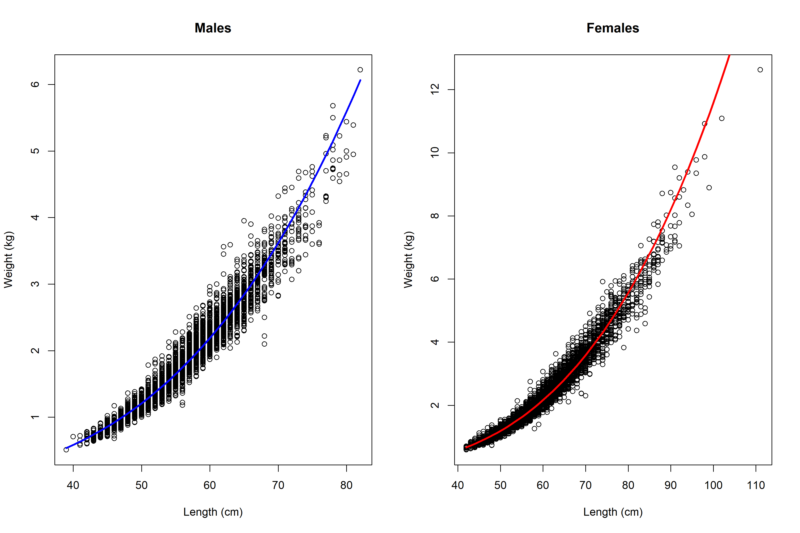
Length-Weight Estimation

Slide 29
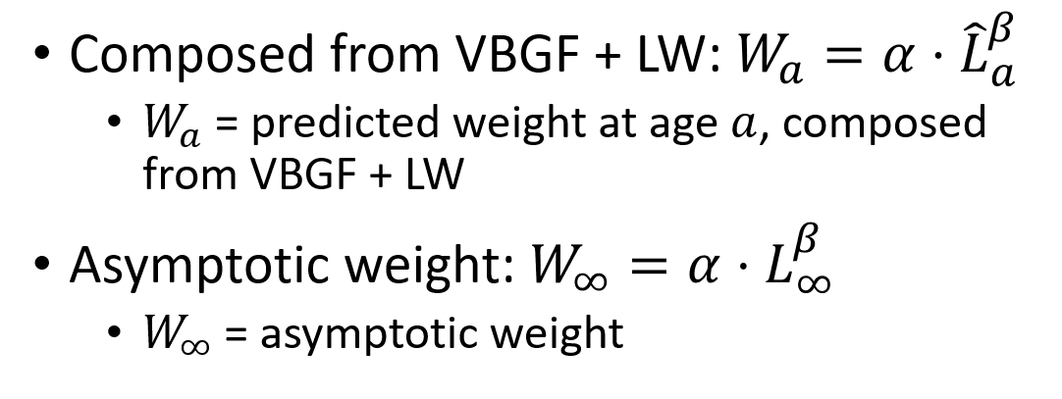
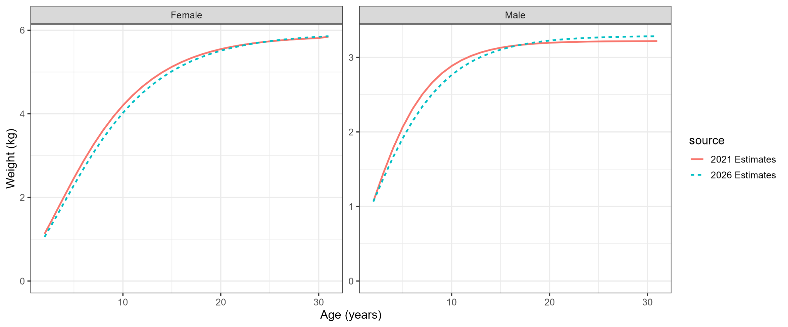
Weight-at-Age Estimation

